Slide 1

18th November 2018
School of Computer Science & Engineering
Lovely Professional University, Phagwara
(June-July, 2018)

Slide 2
PRESENTATION OF INTRODUCTION TO DATA MANAGEMENT ON IPL DATA ANALYSIS
PowerPoint presentation for INT 217…
T
O
P
I
C
By
N S Charan Reddy
11601863
B.Tech CSE
UNDER THE GUIDANCE OF
SANDEEP KAUR

Slide 3
MY PROJECT WORKBOOK IS . . . 1. ENCRYPTED 2. STRUCTURE PROTECTED 3. RESTRICTED TO ACCESS 4. FLAW LESS (UP TO MY KNOWLEDGE)

Slide 4
TECHNOLOGIES USED SSIS Packages data cleaning pre processing excel for analysis ipython for separating team wise analysis

Slide 5
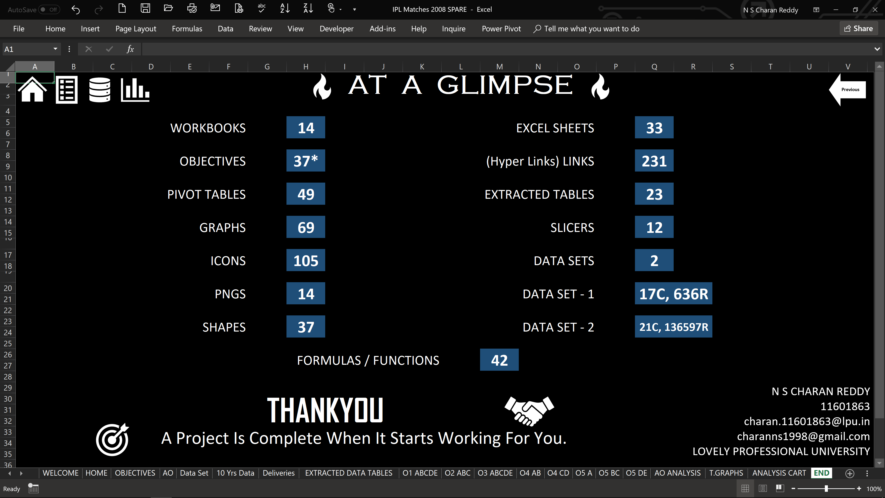

Slide 6
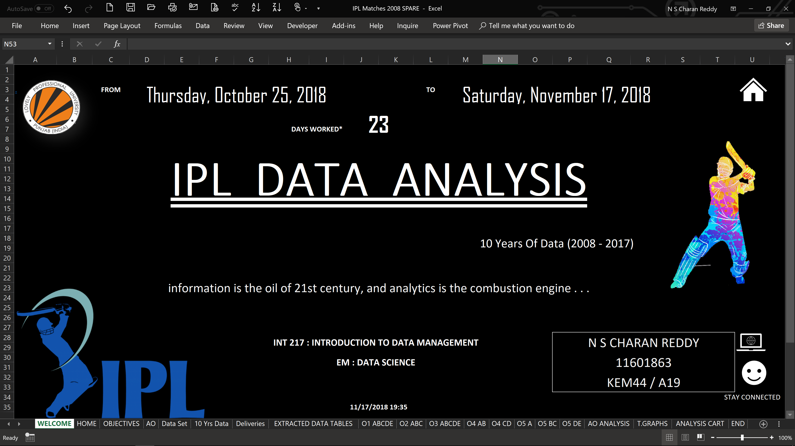

Slide 7
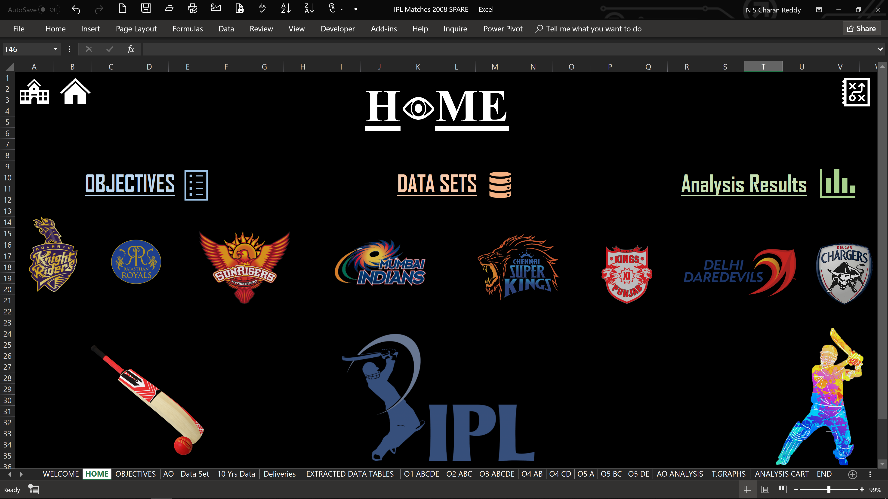

Slide 8
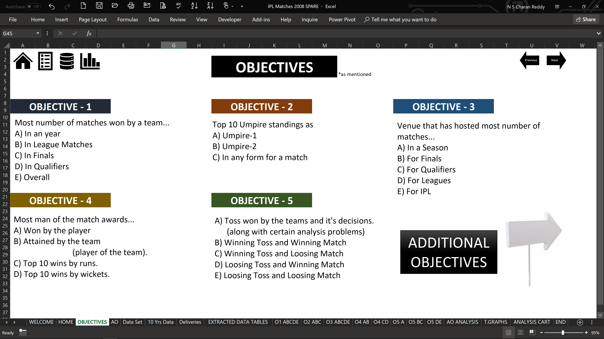

Slide 9
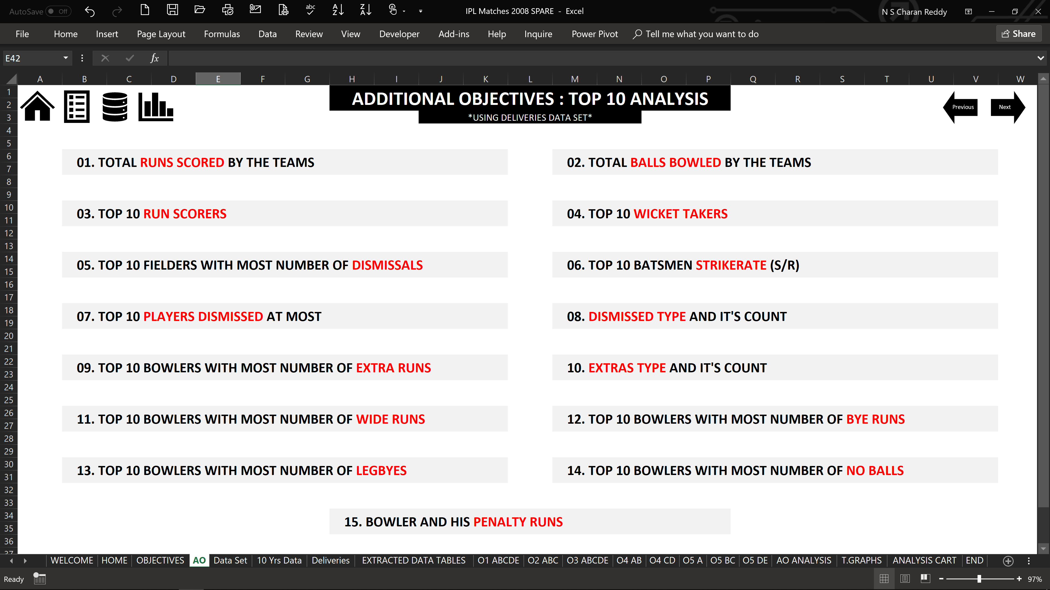

Slide 10
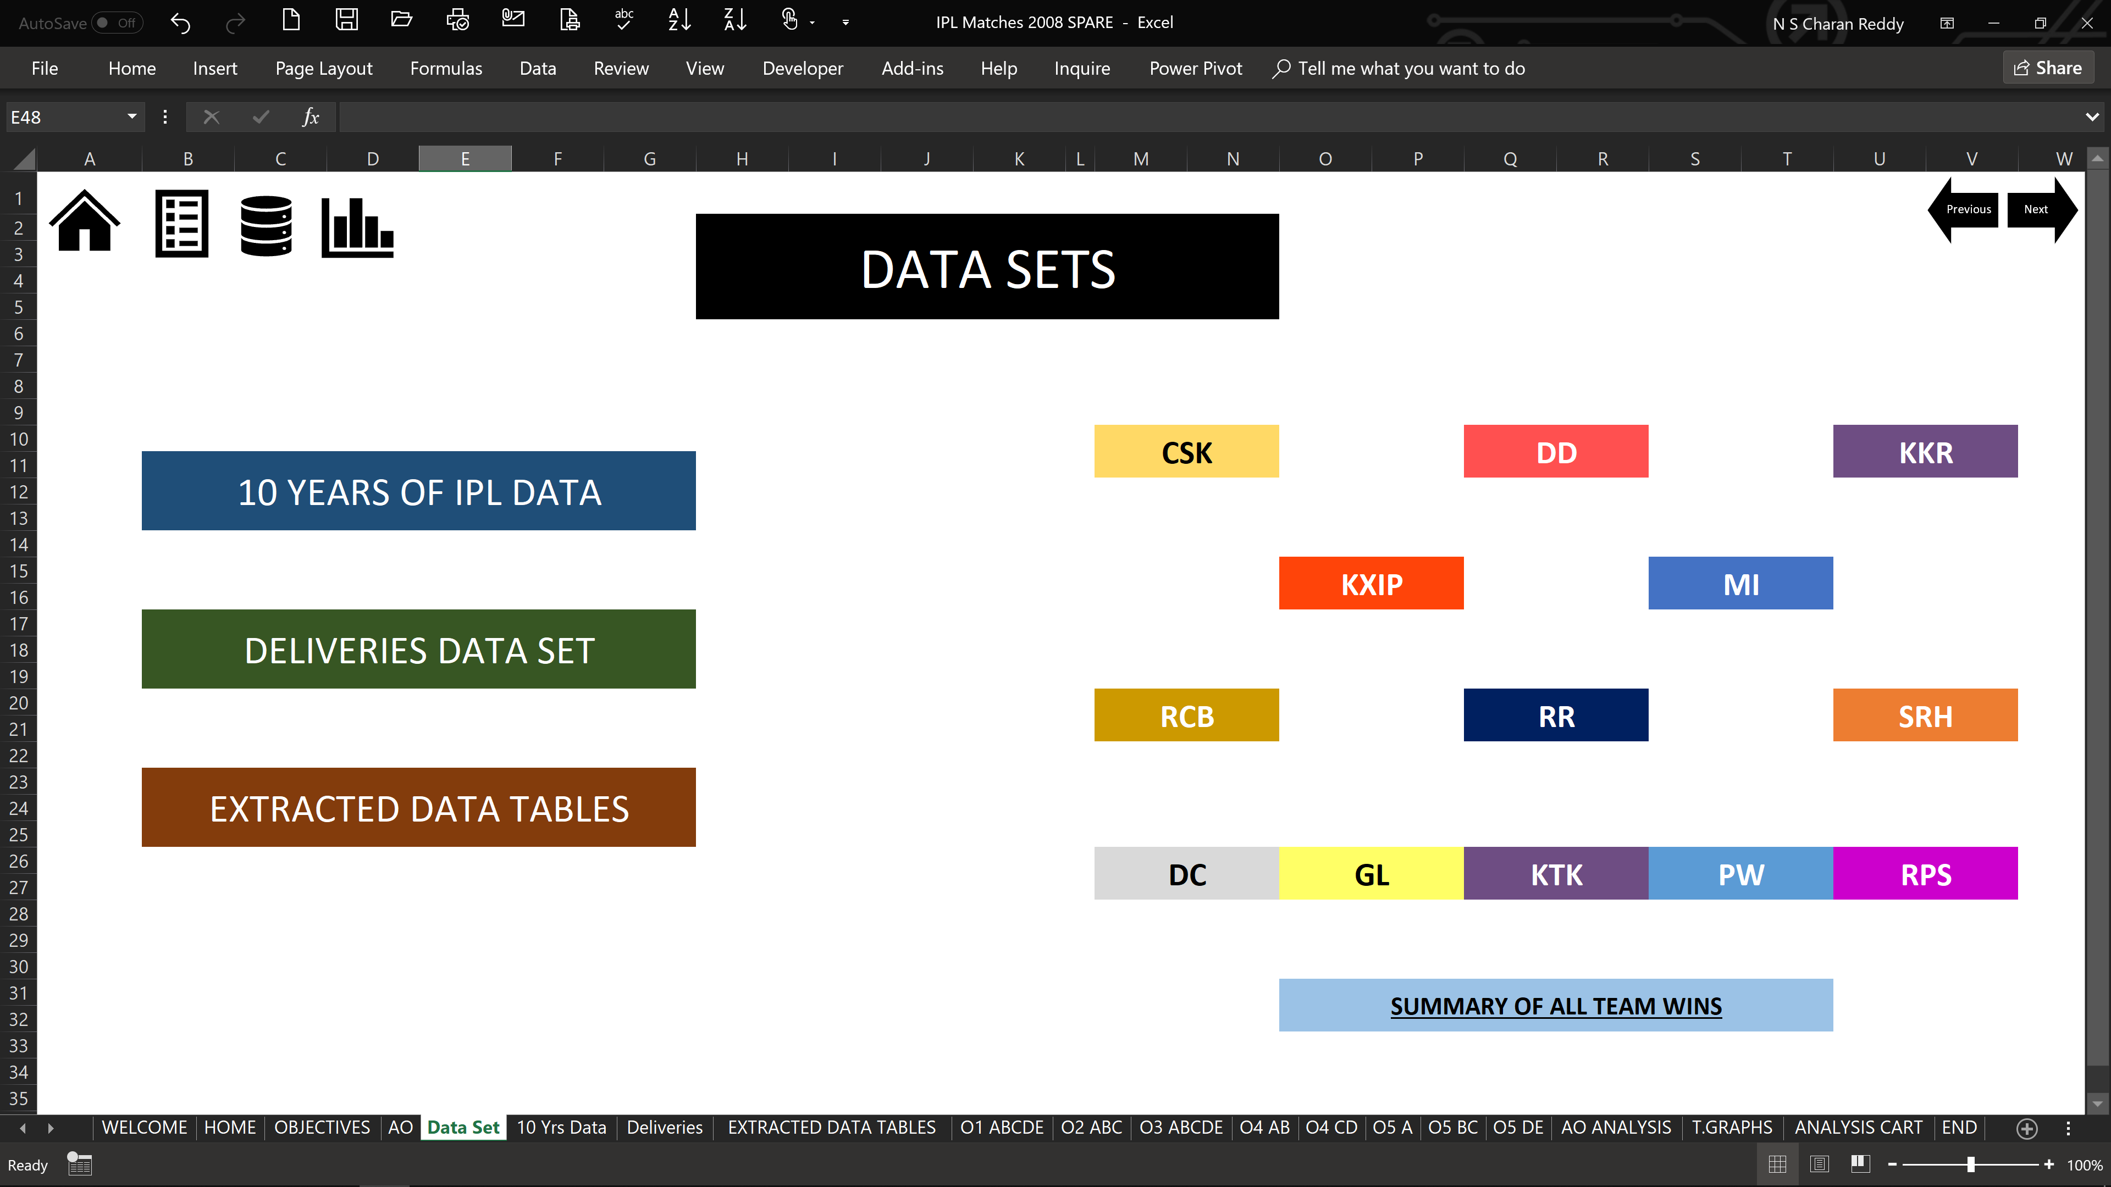

Slide 11
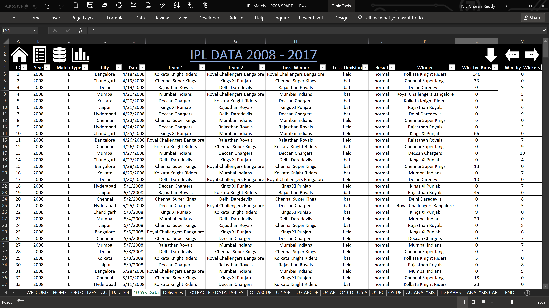

Slide 12
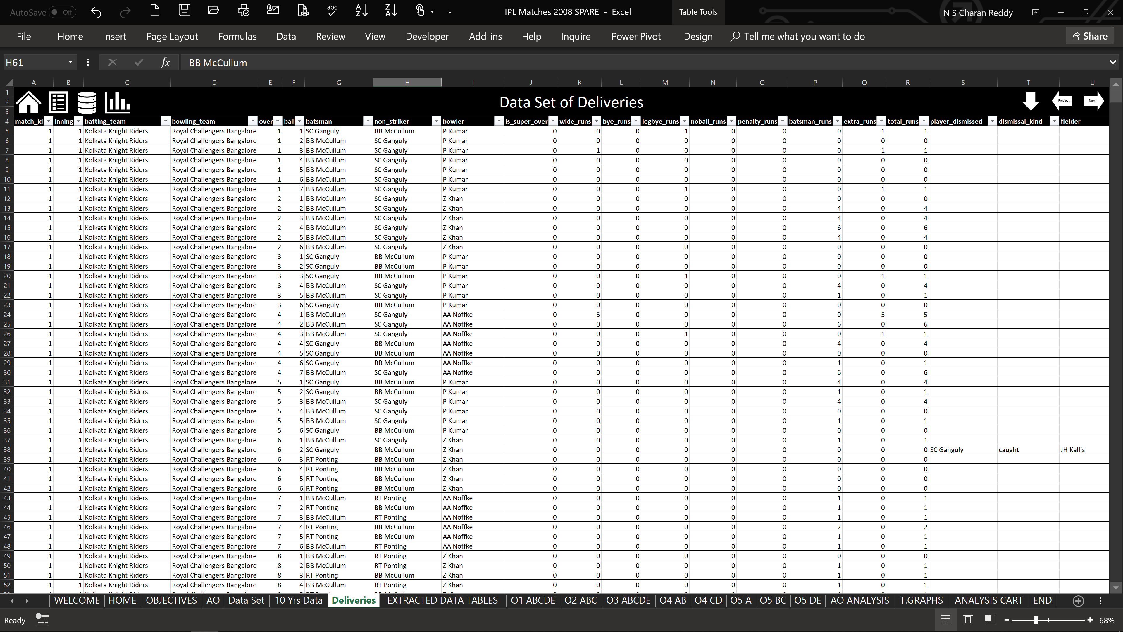

Slide 13
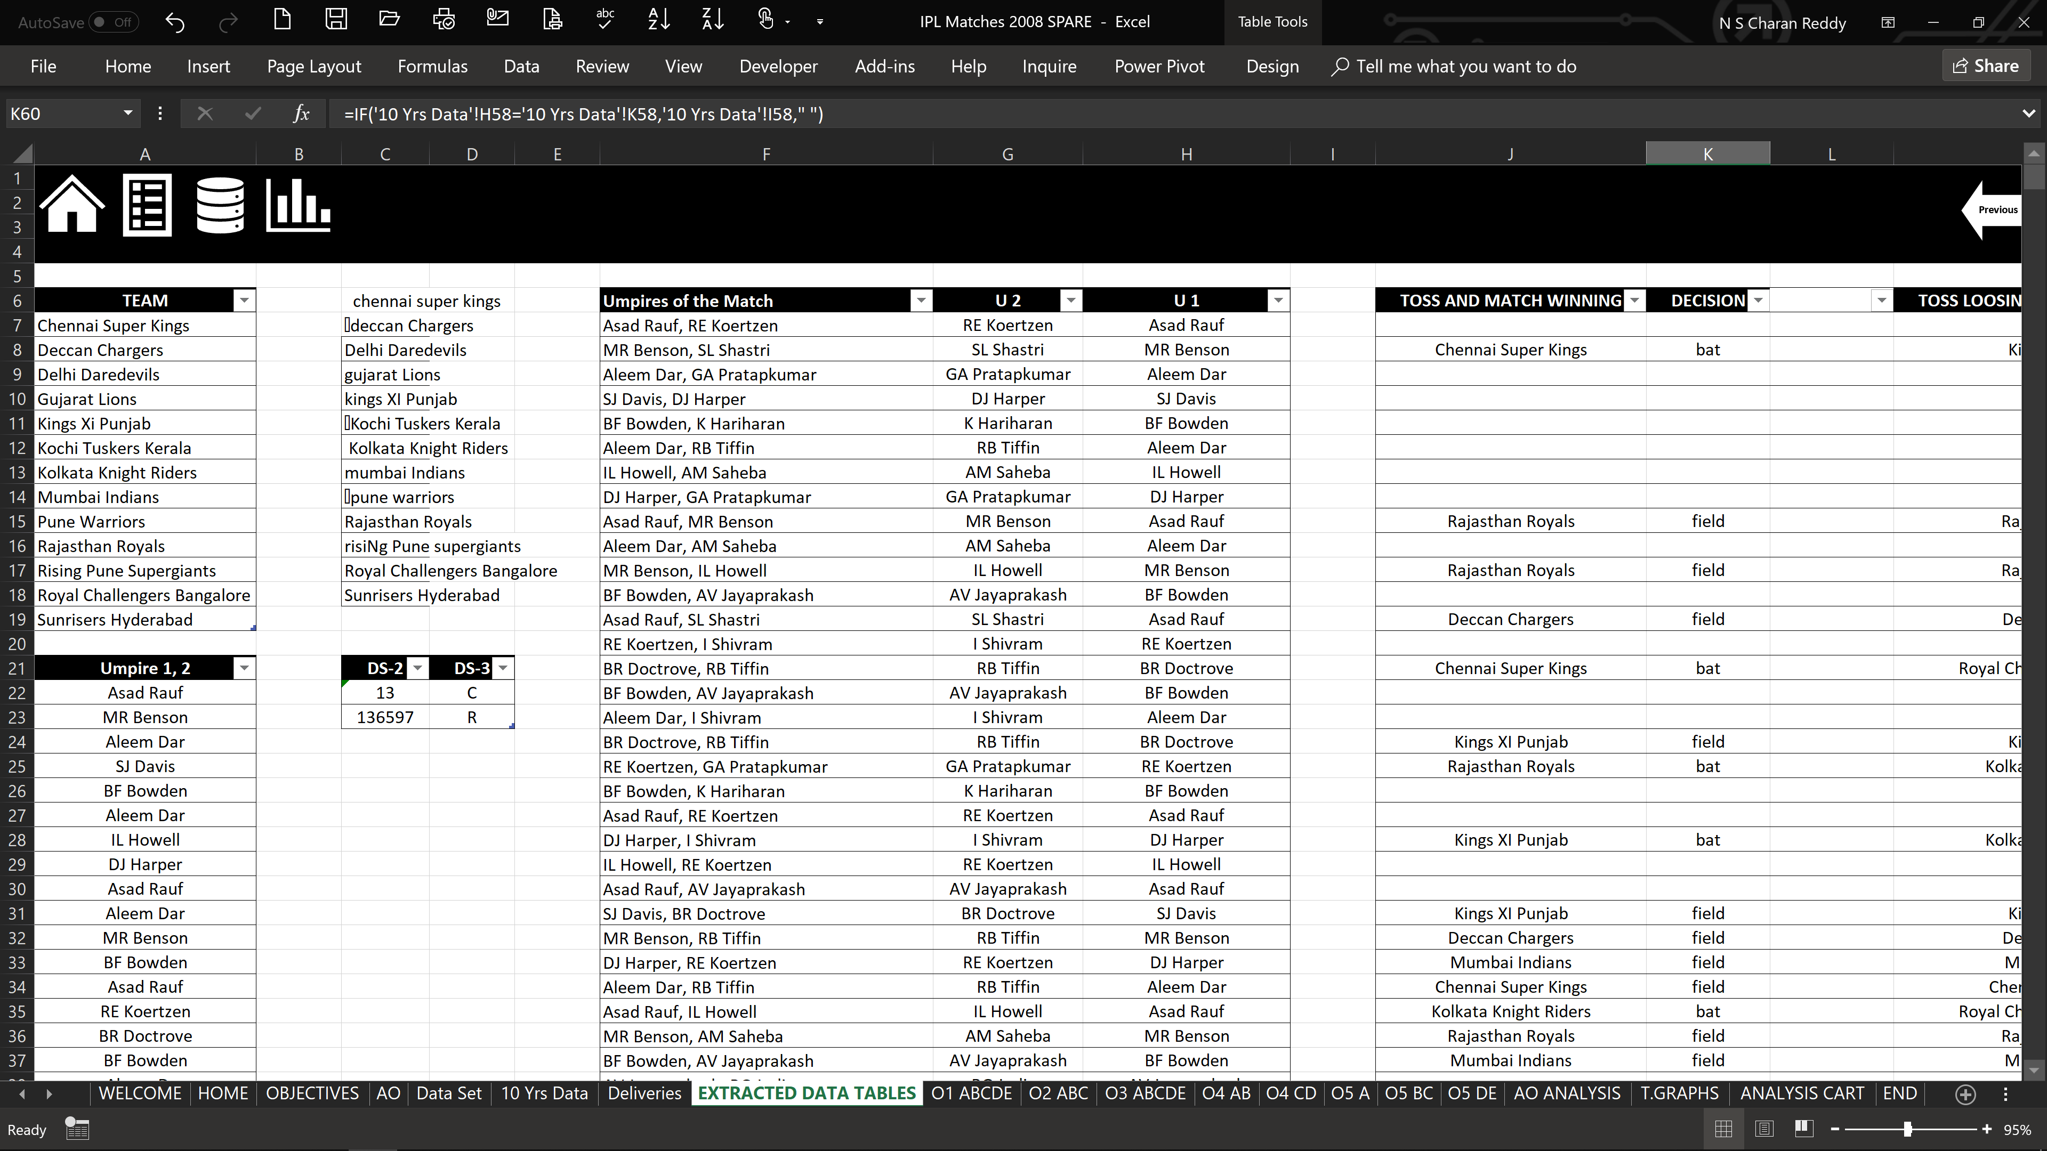

Slide 14
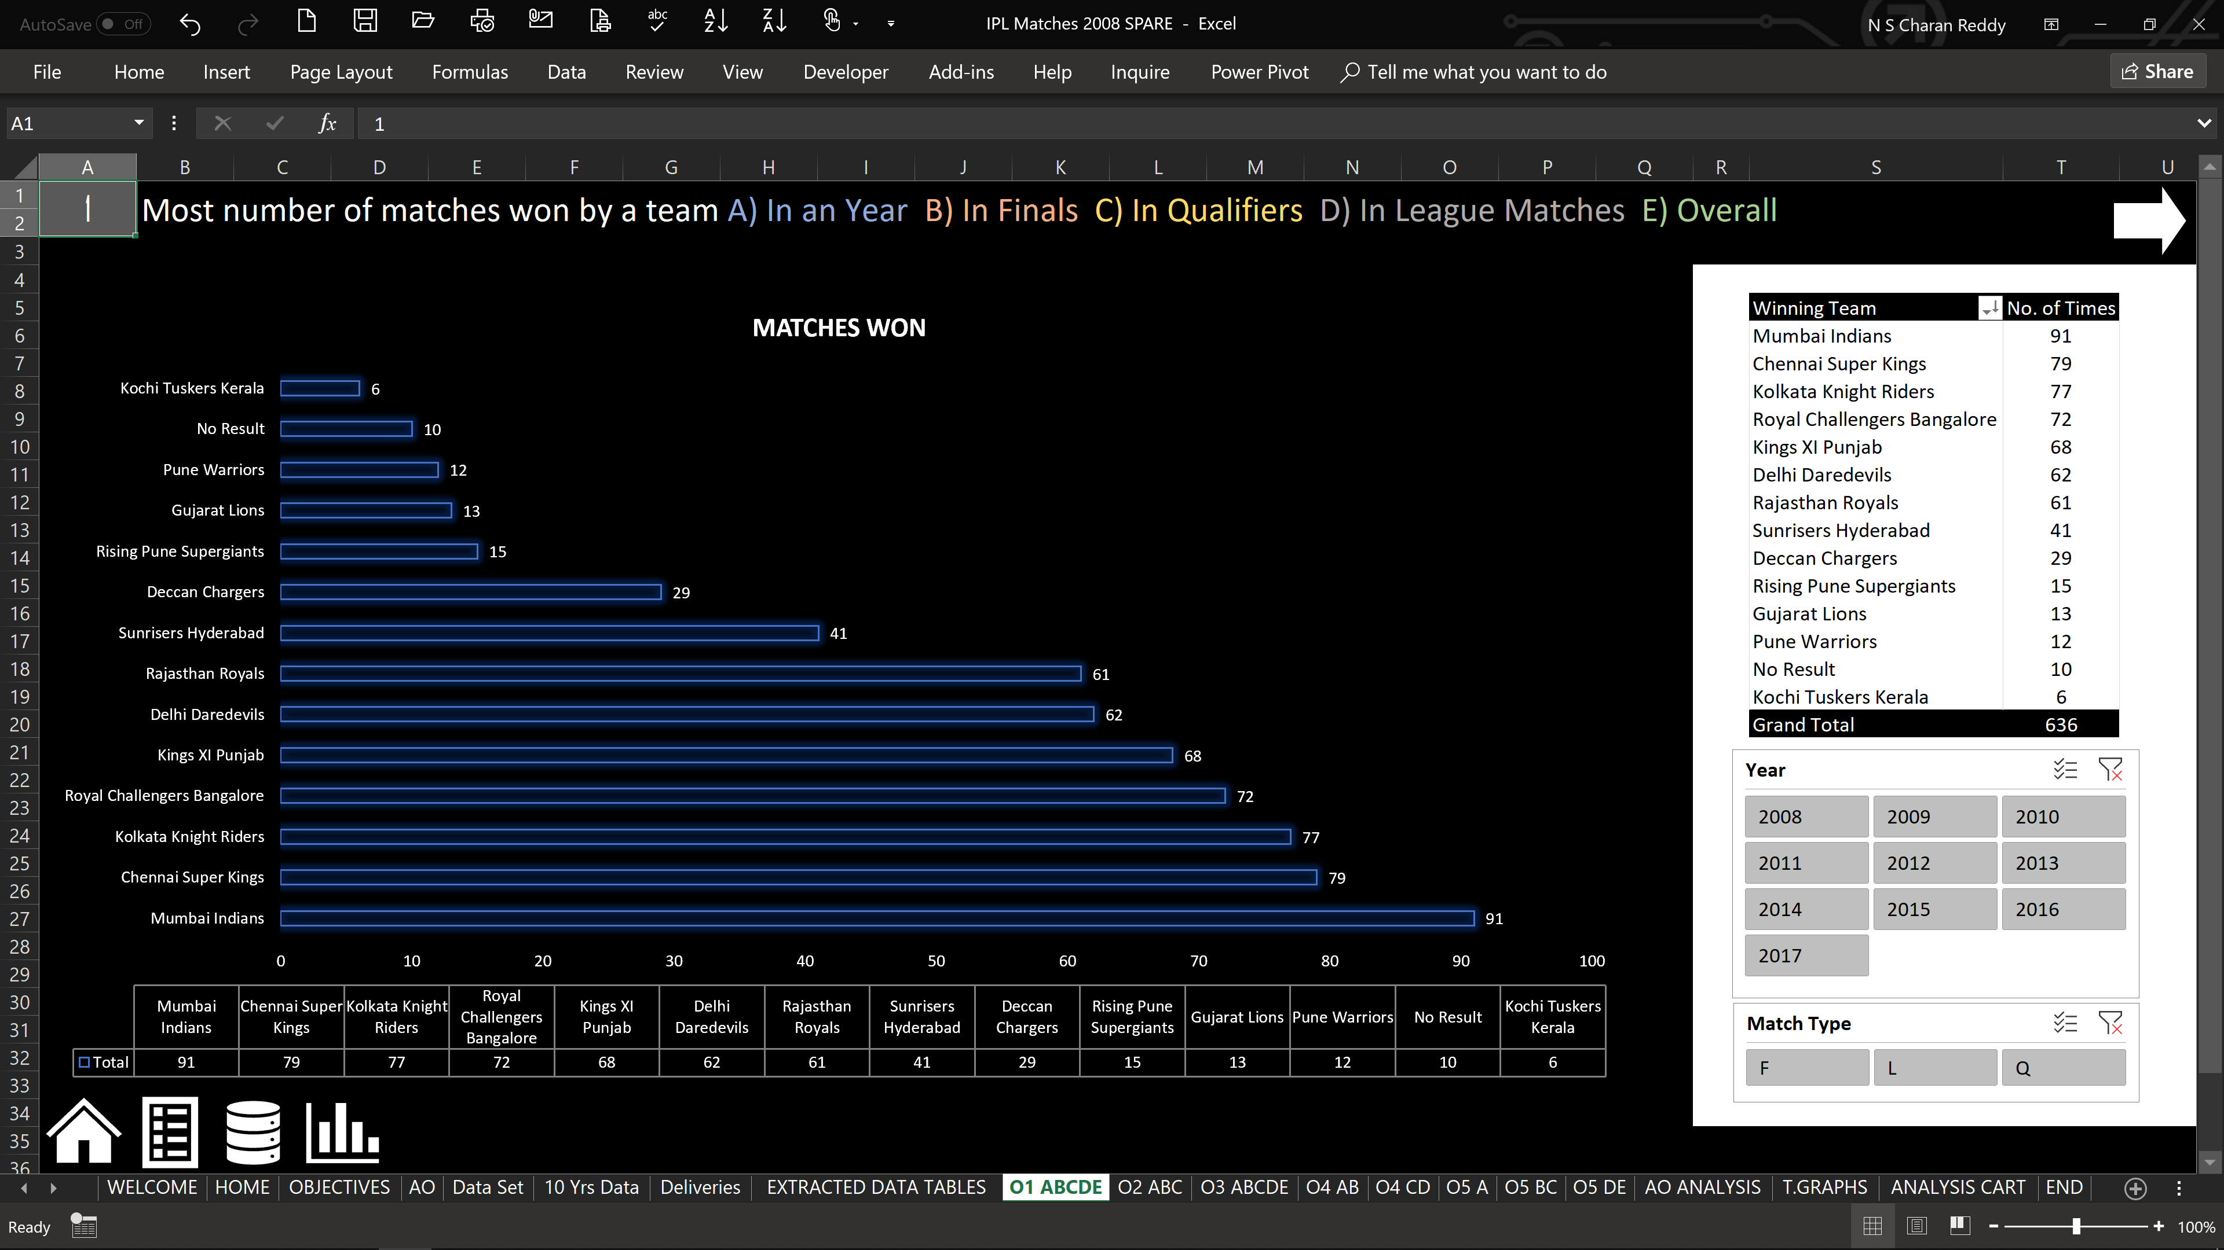

Slide 15
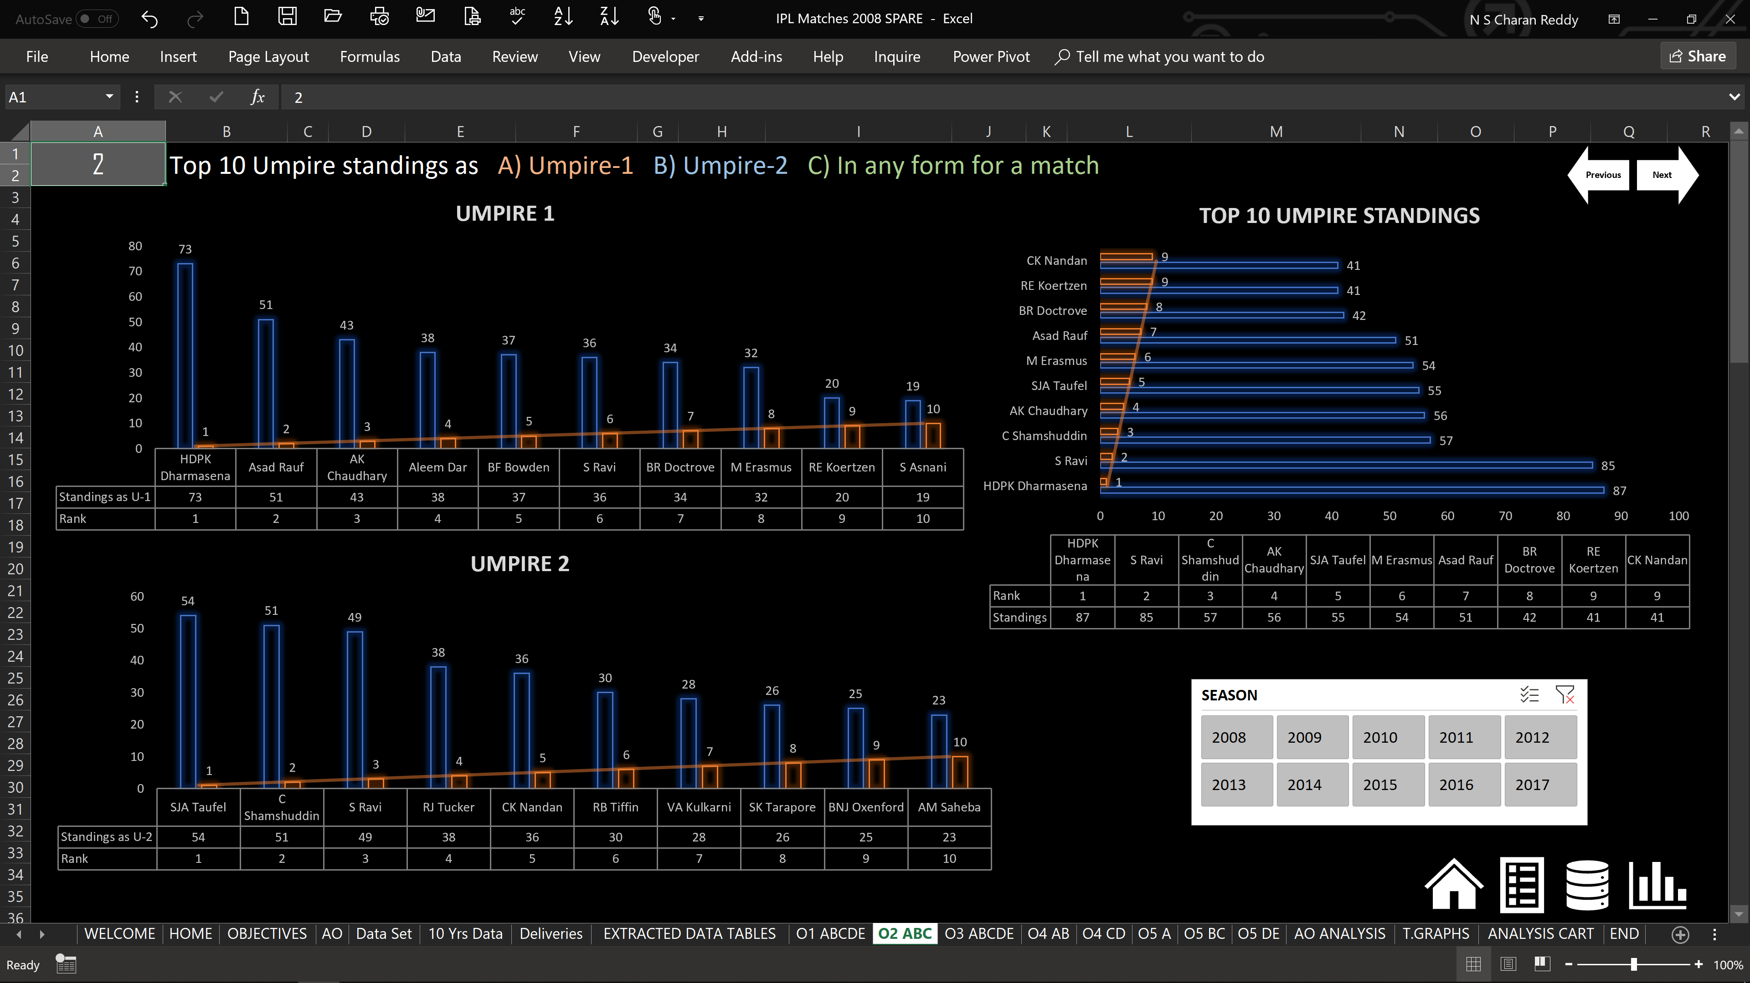

Slide 16
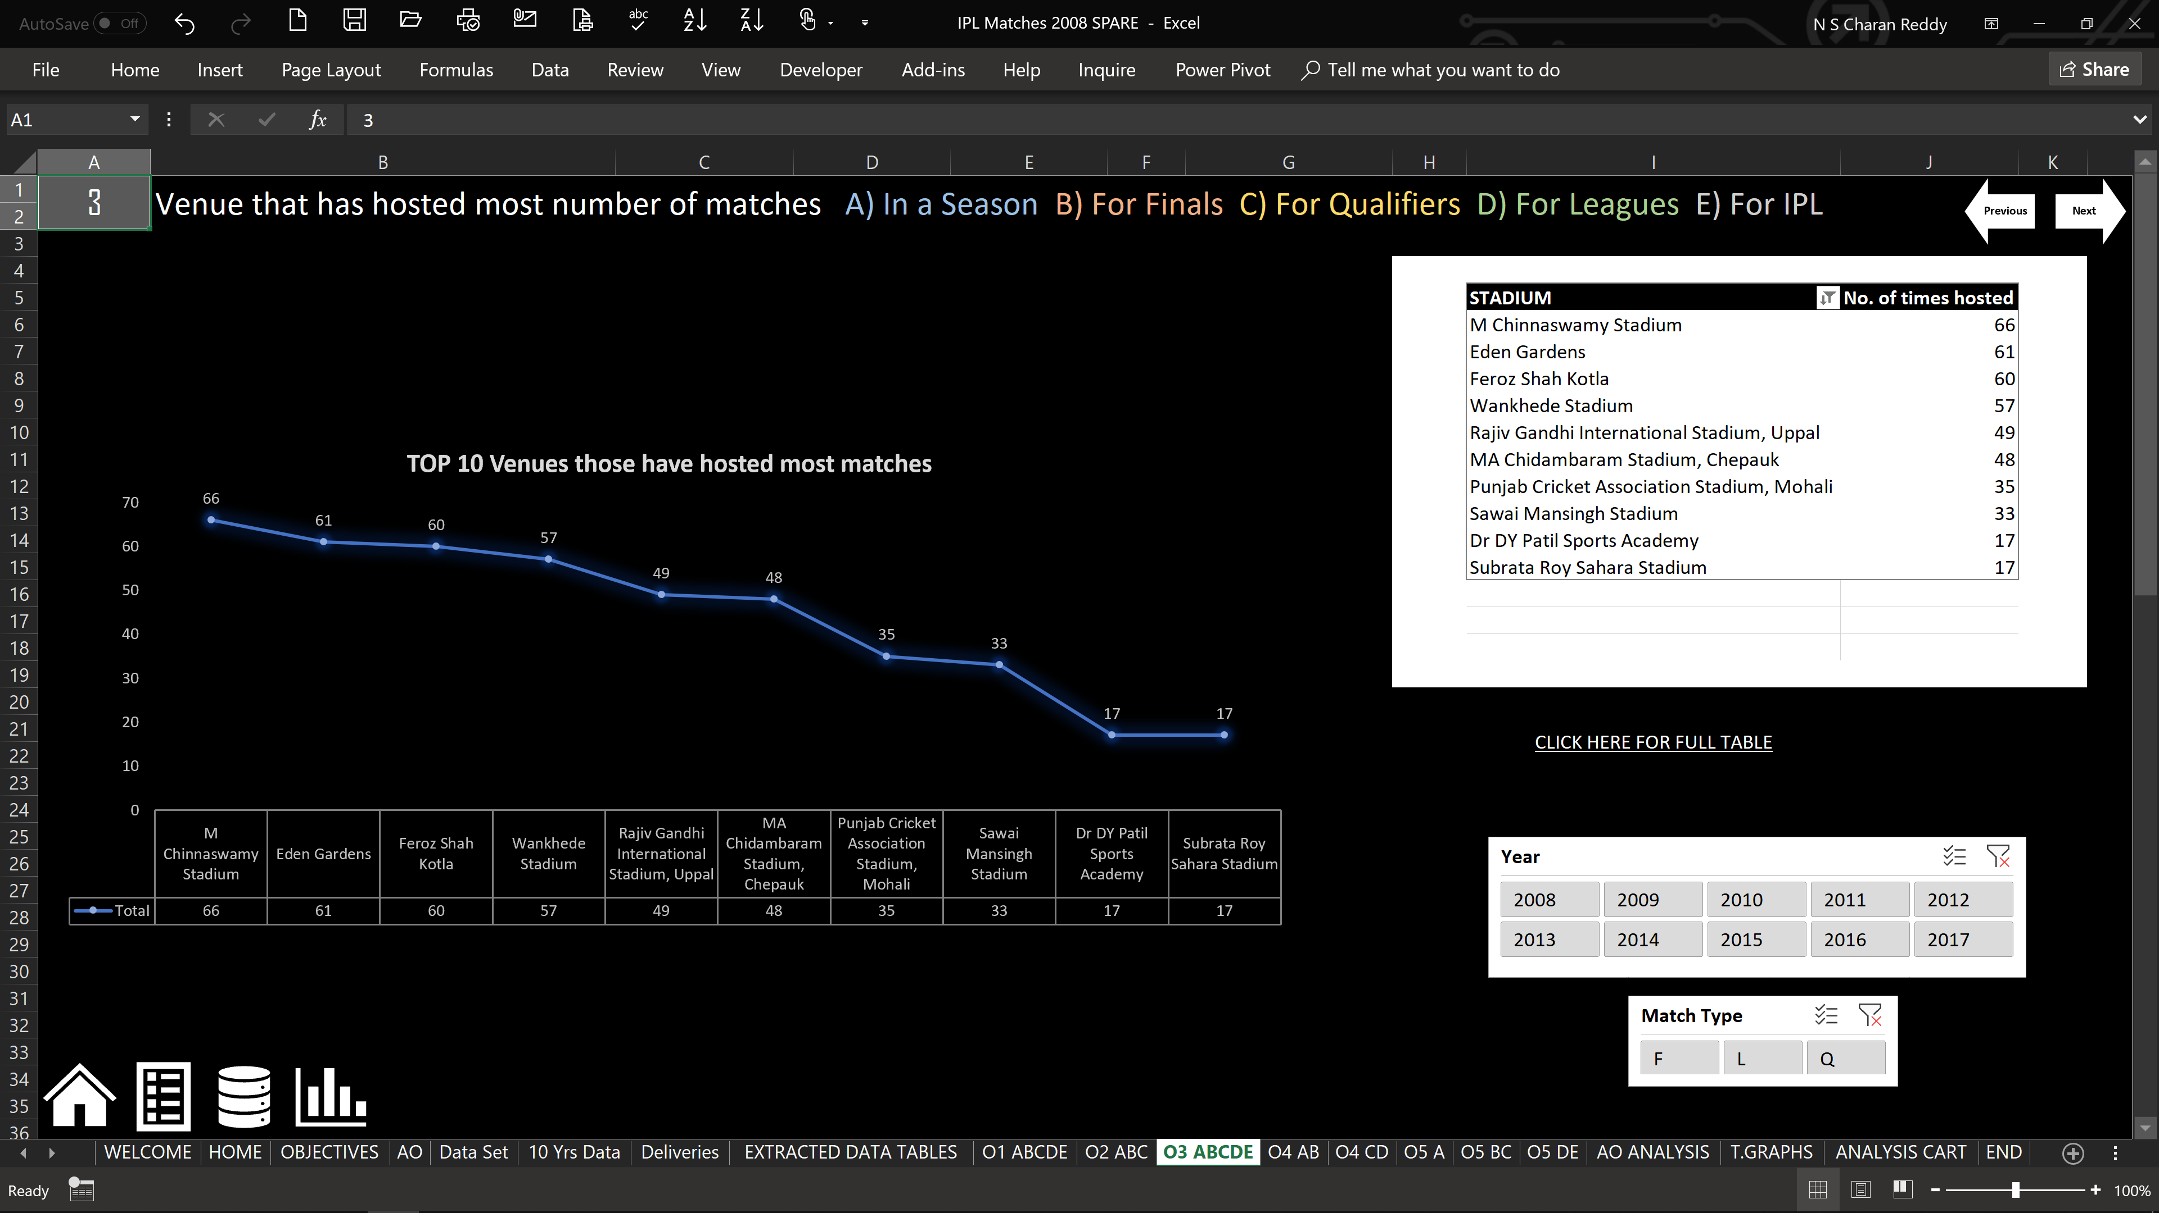

Slide 17
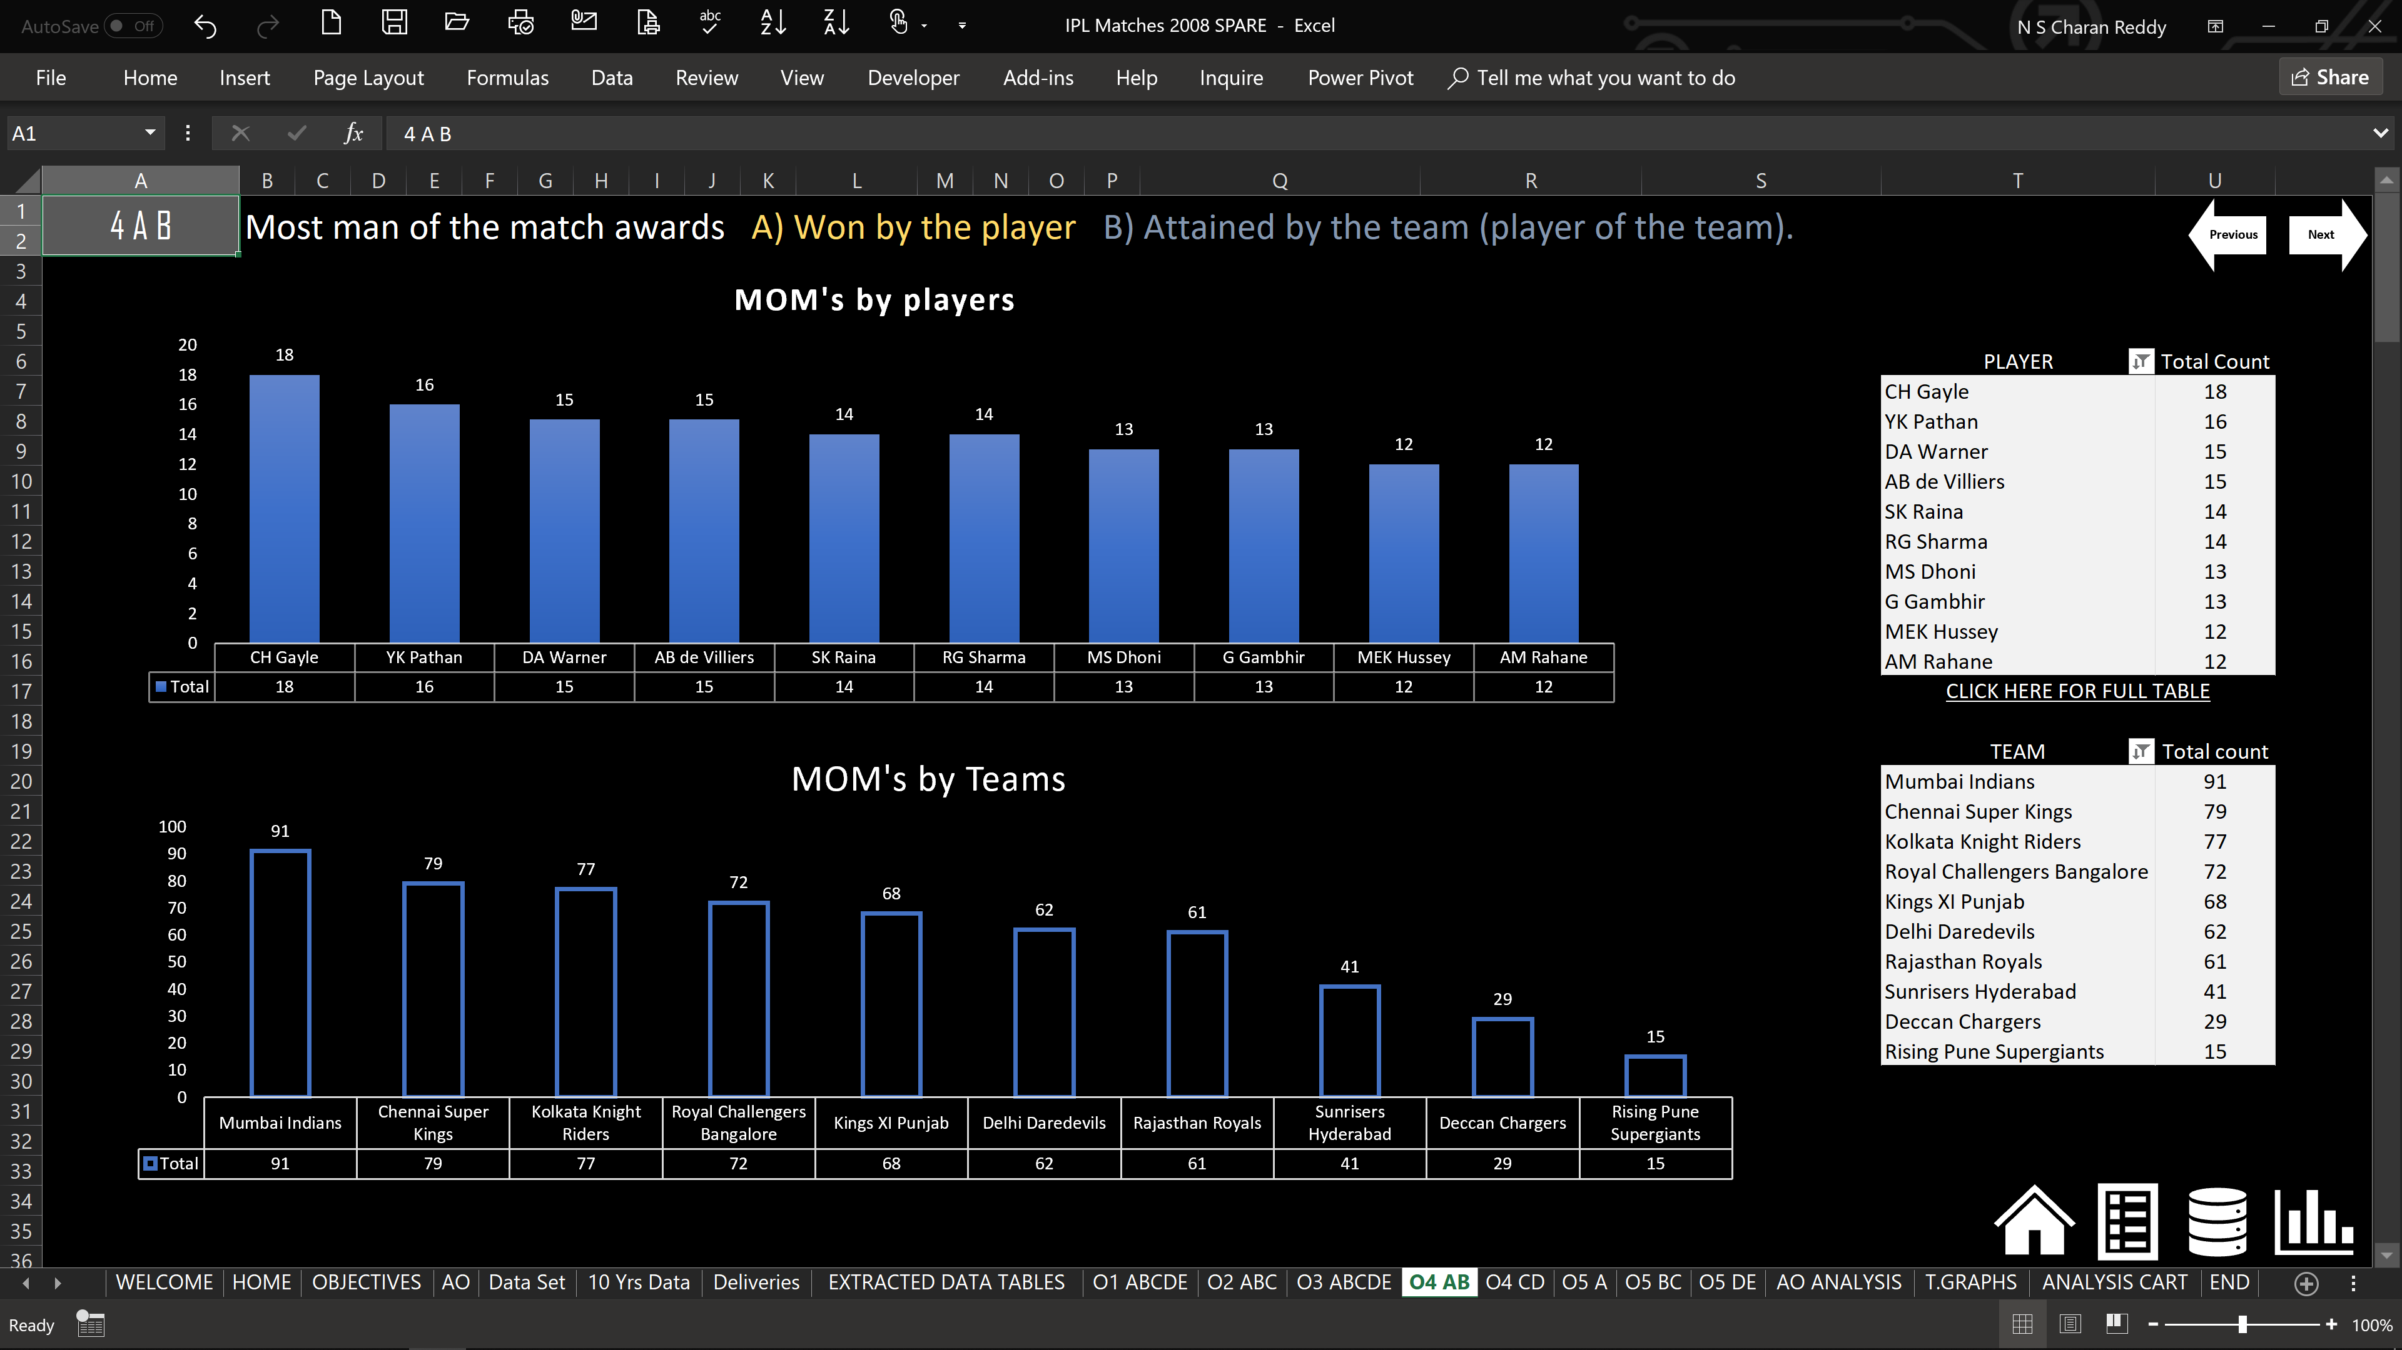

Slide 18
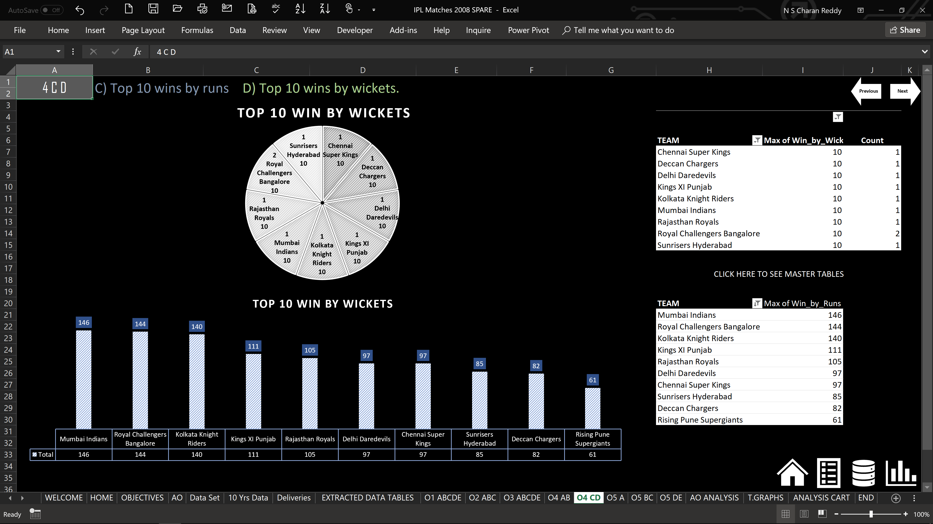

Slide 19
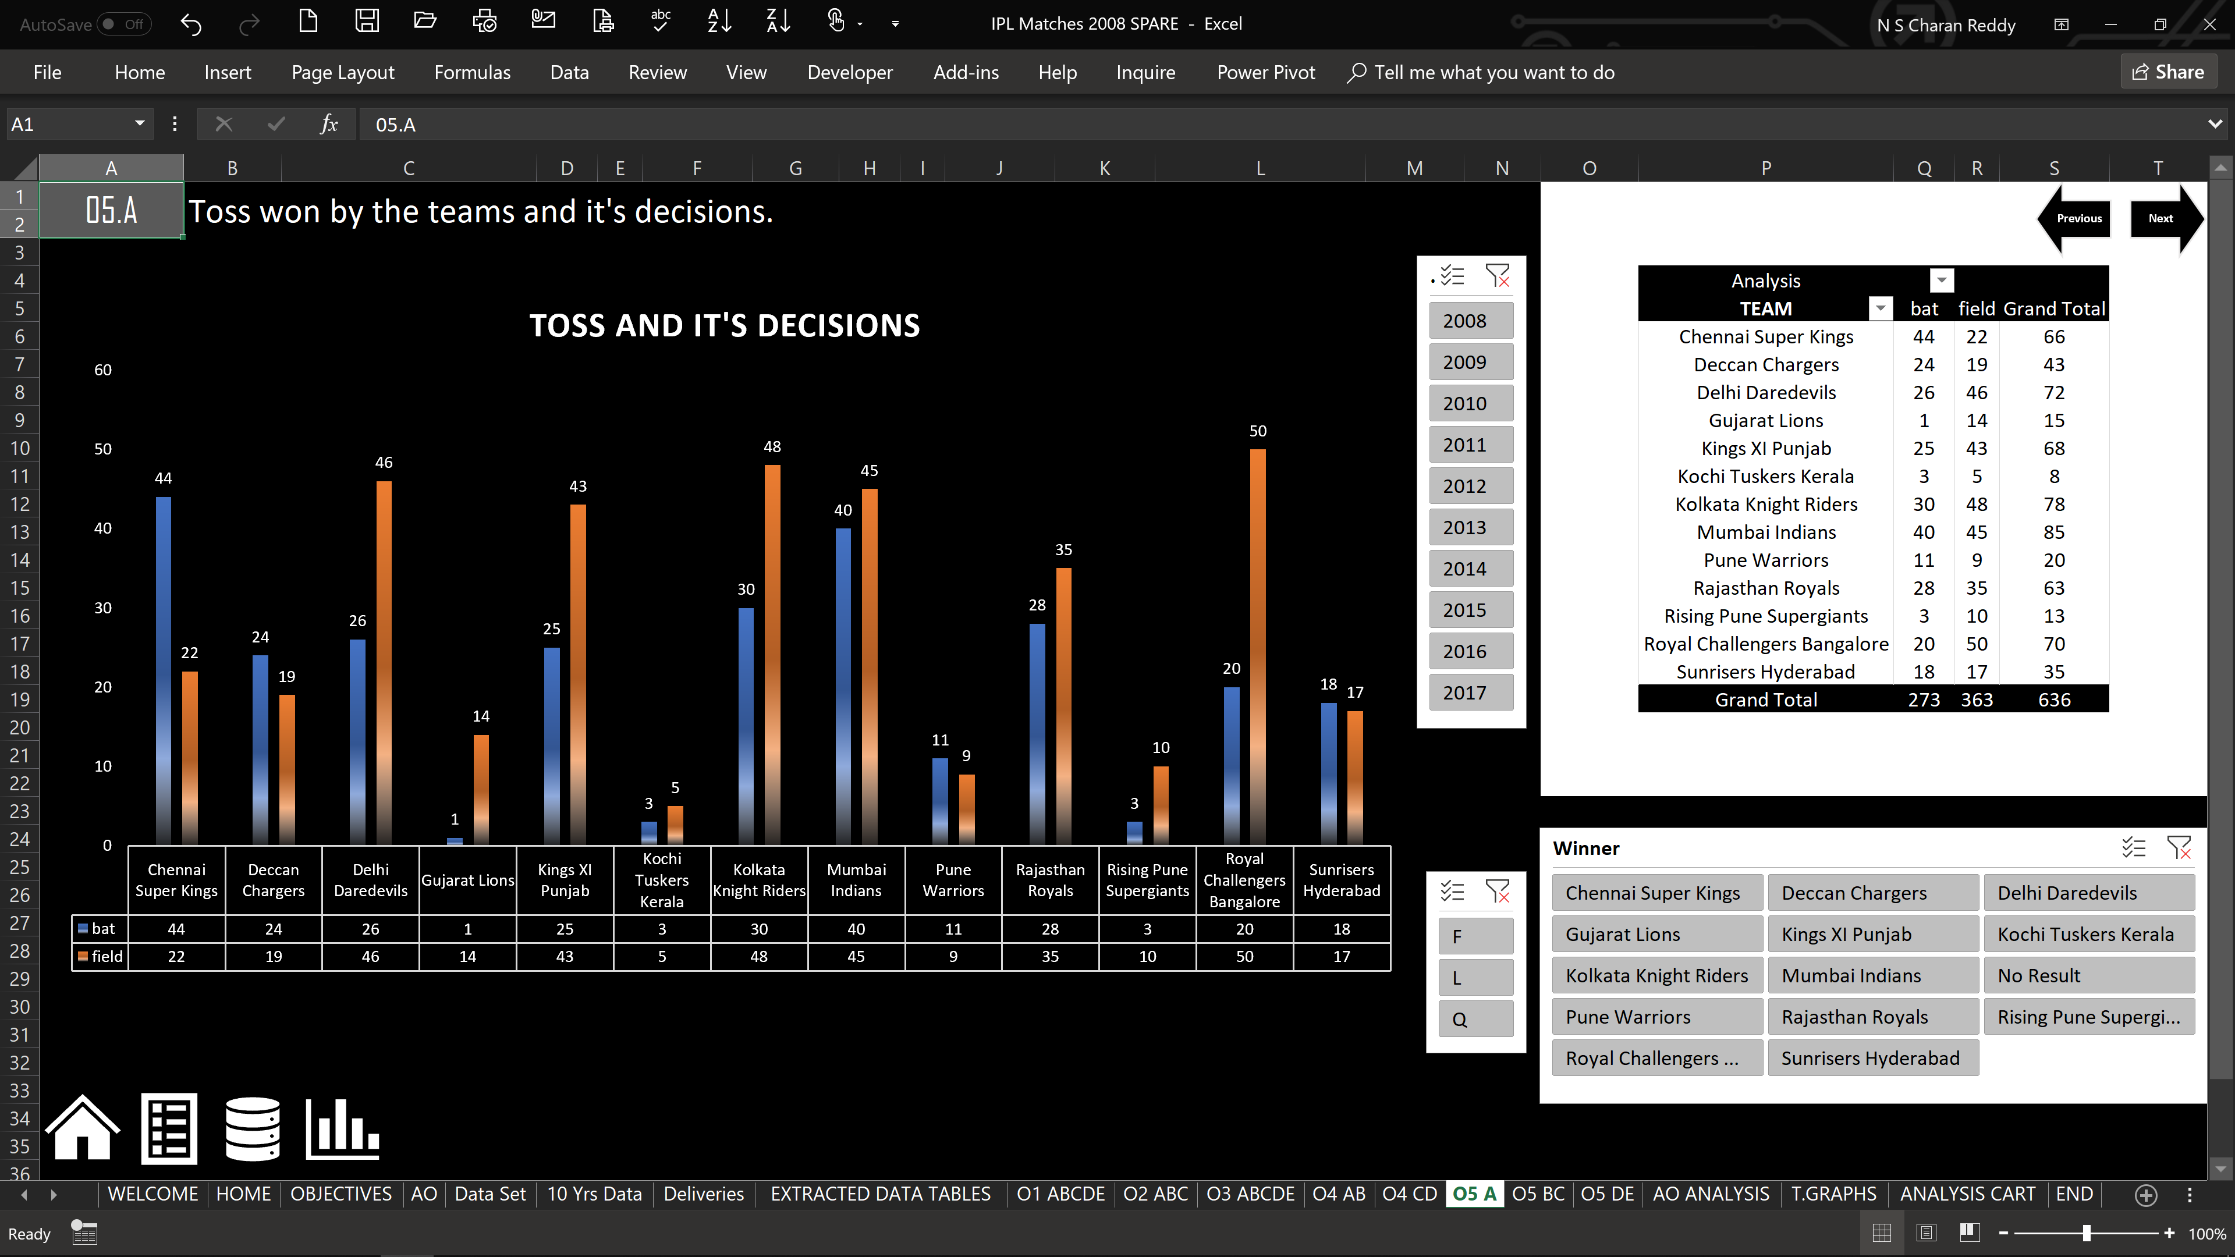

Slide 20
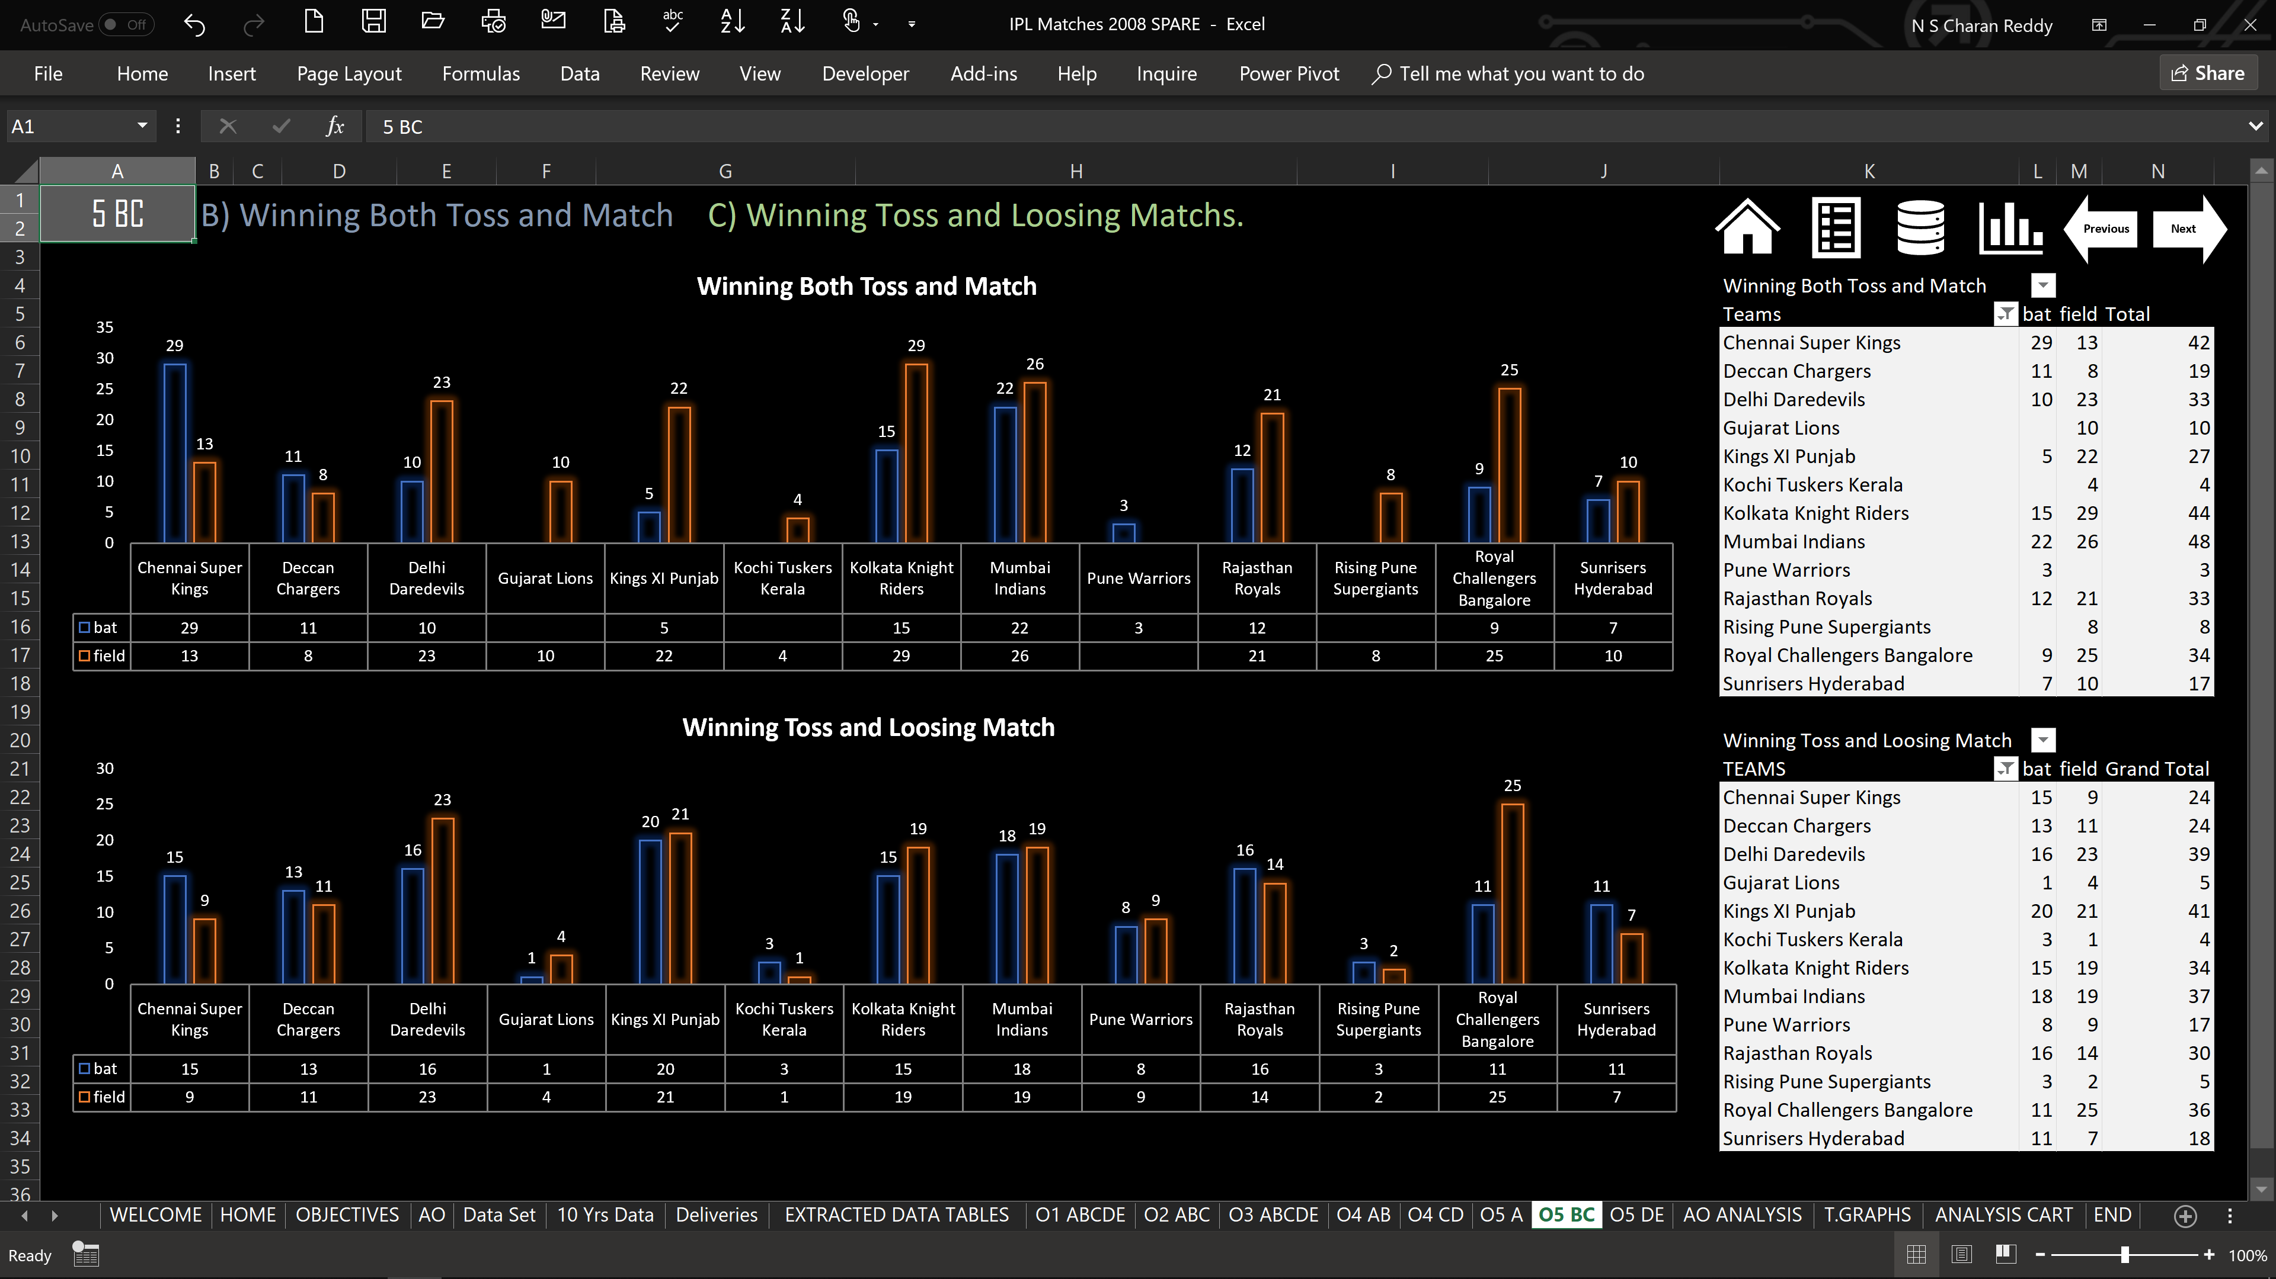

Slide 21
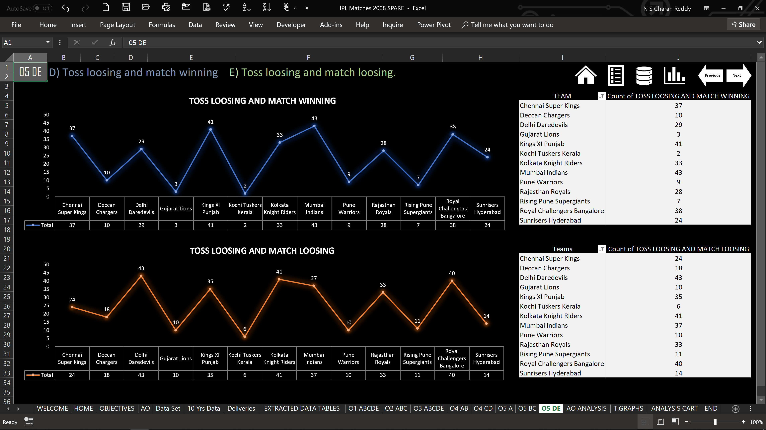

Slide 22
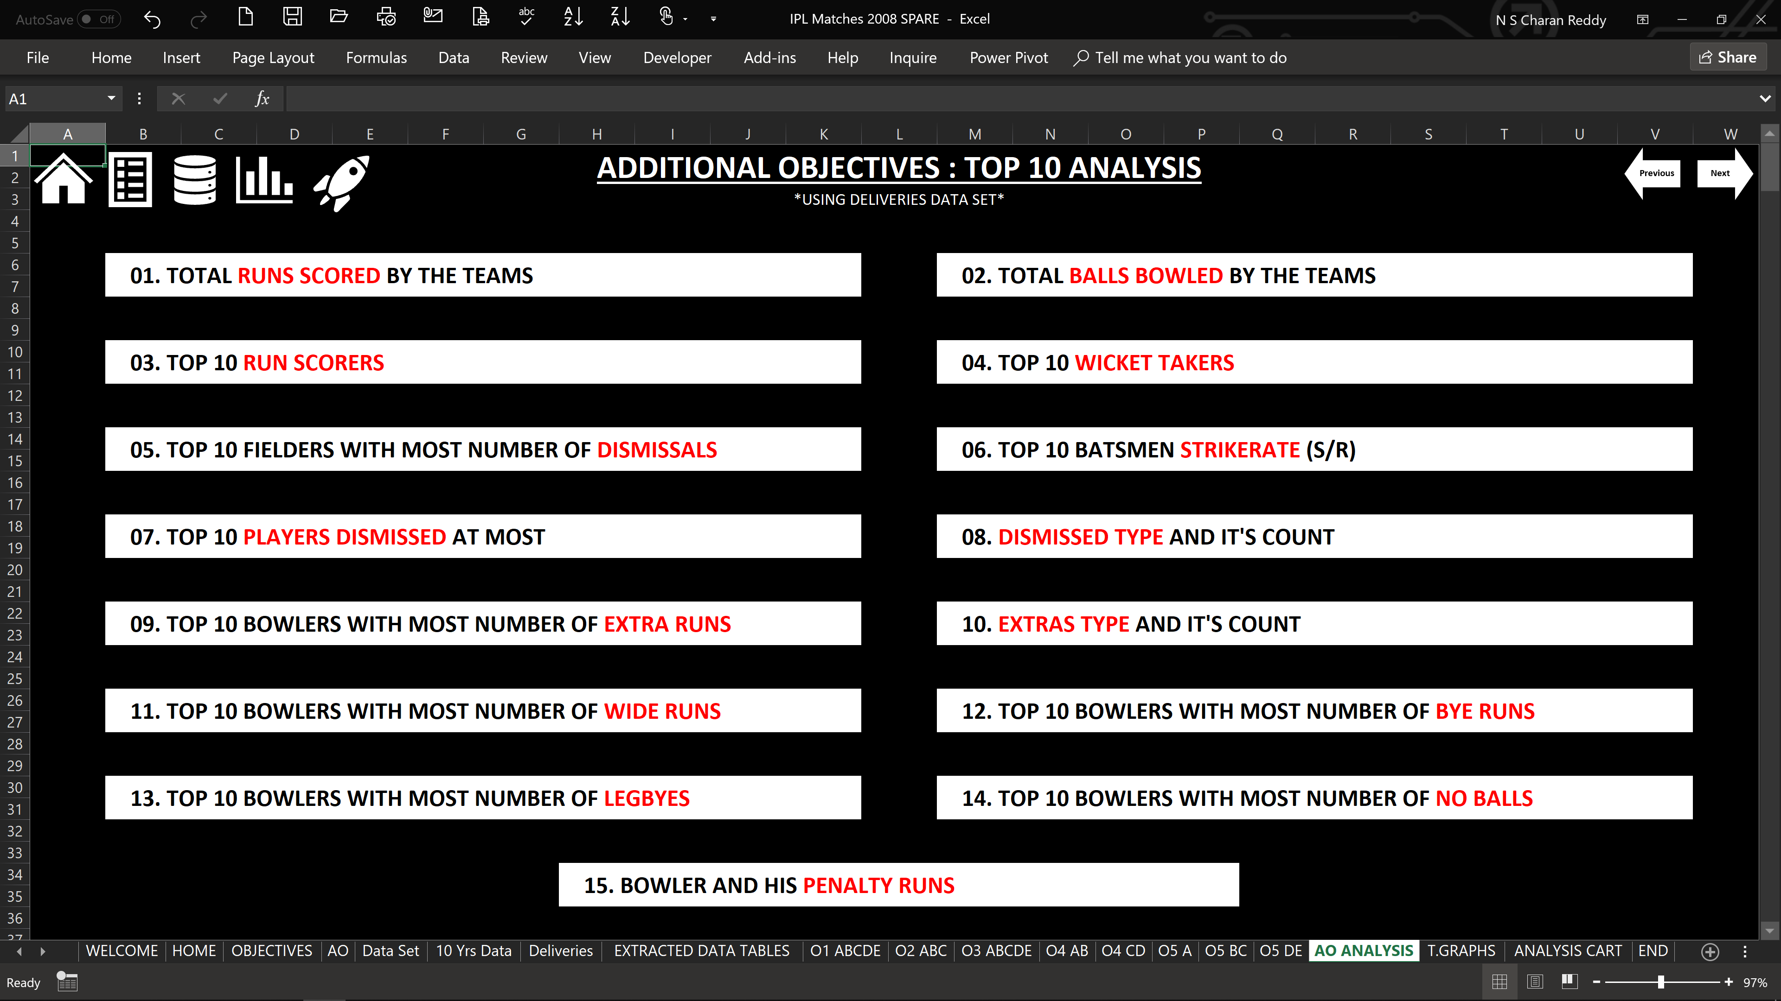

Slide 23
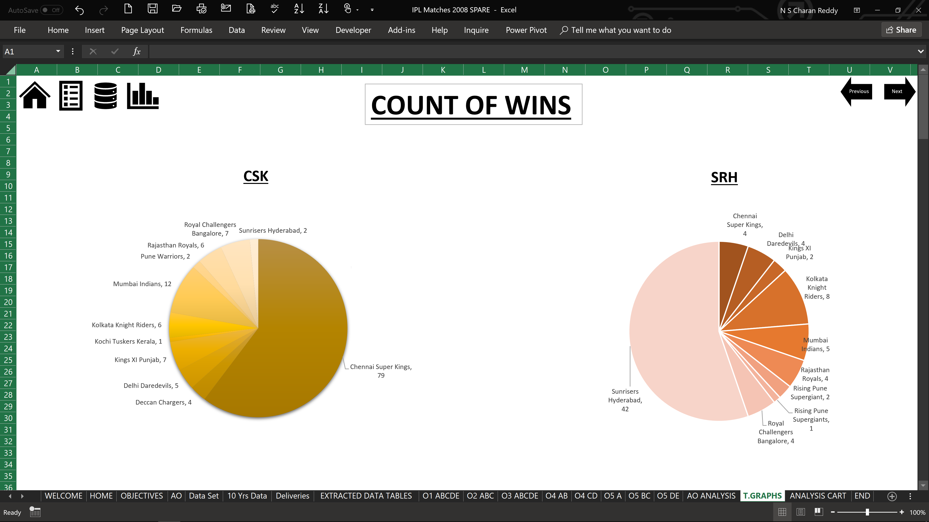

Slide 24
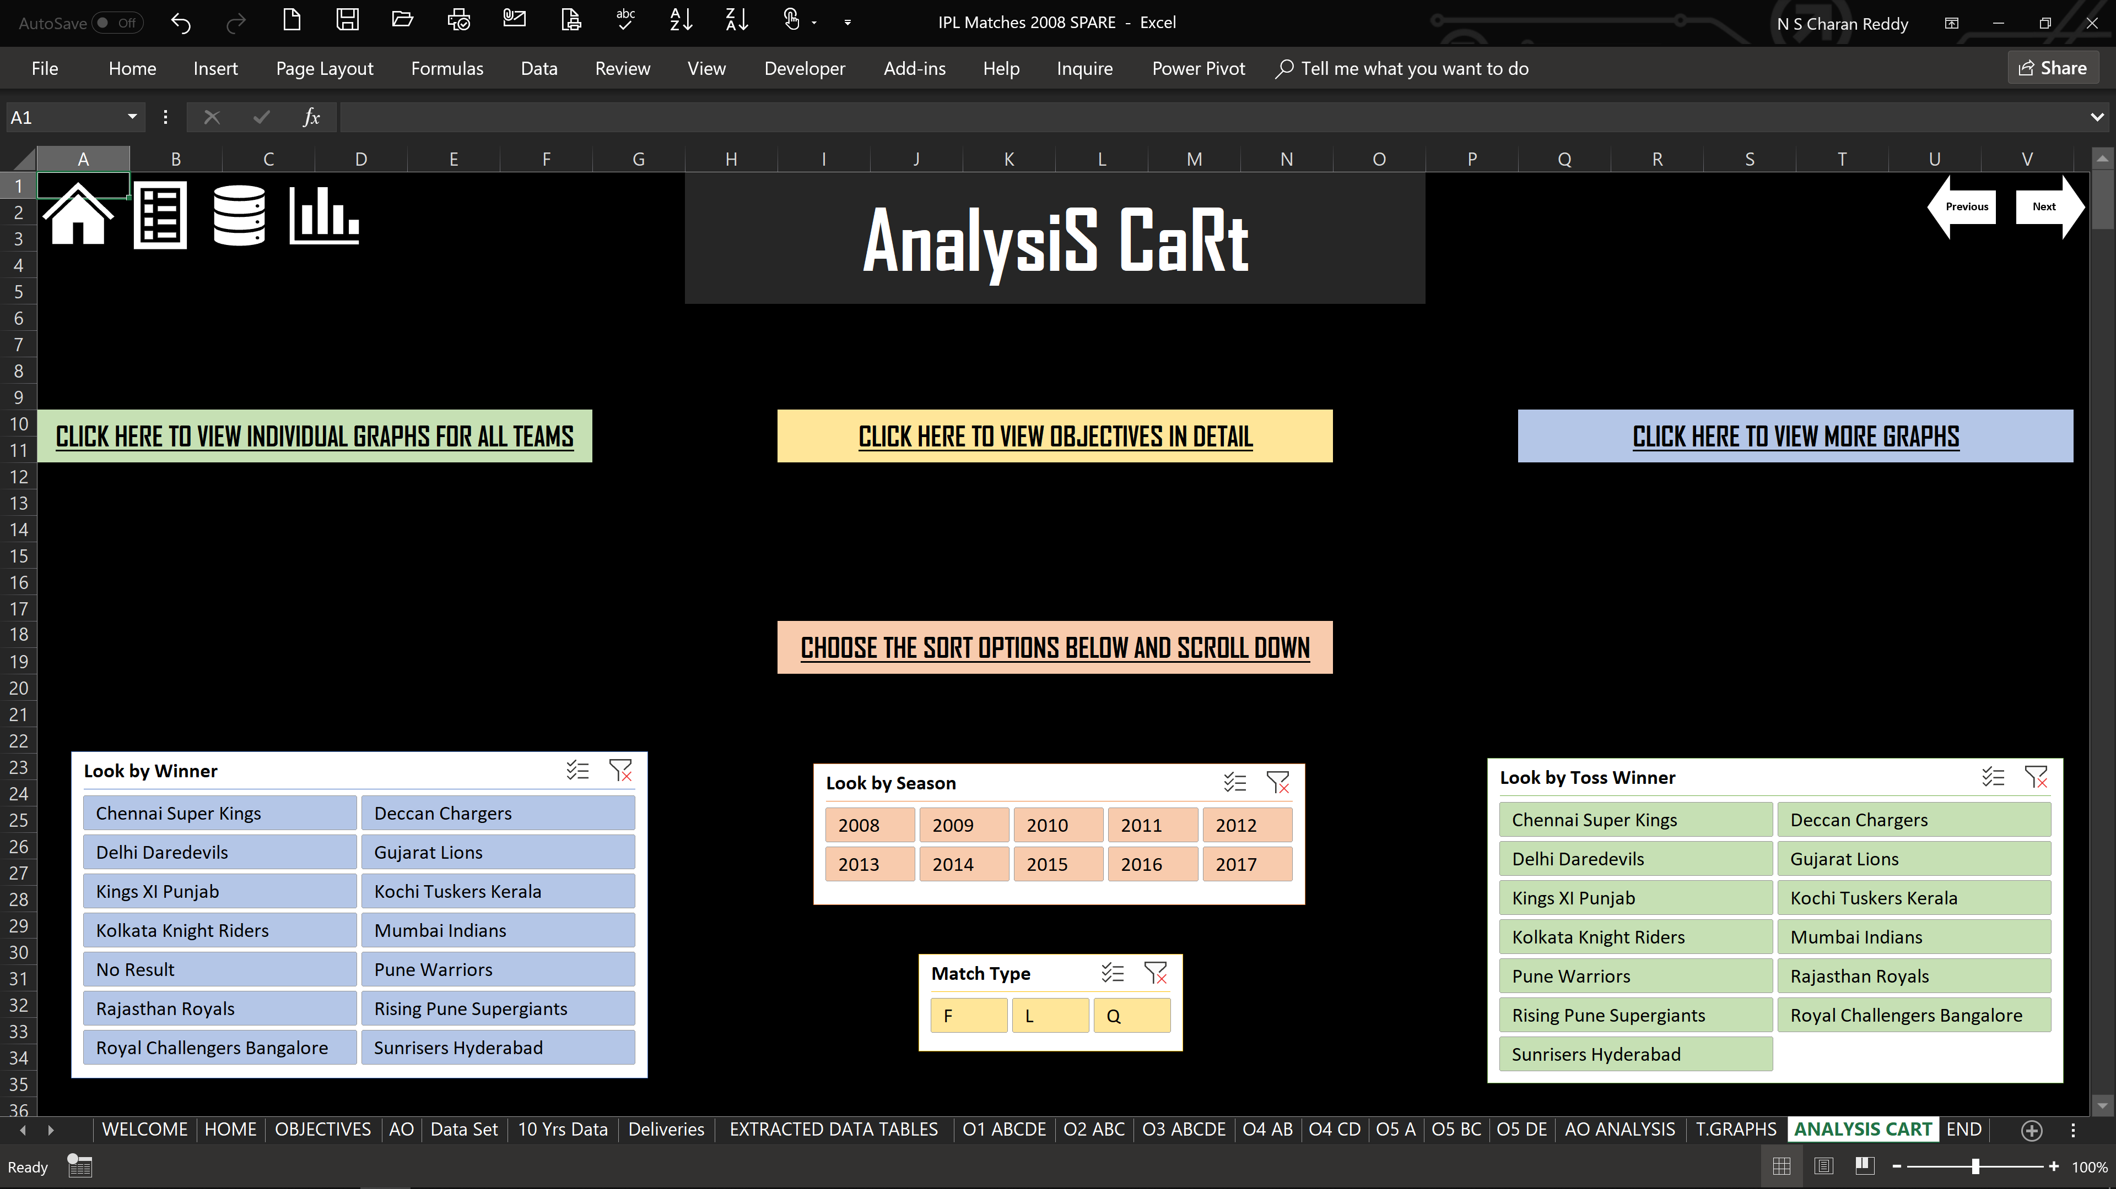

Slide 26
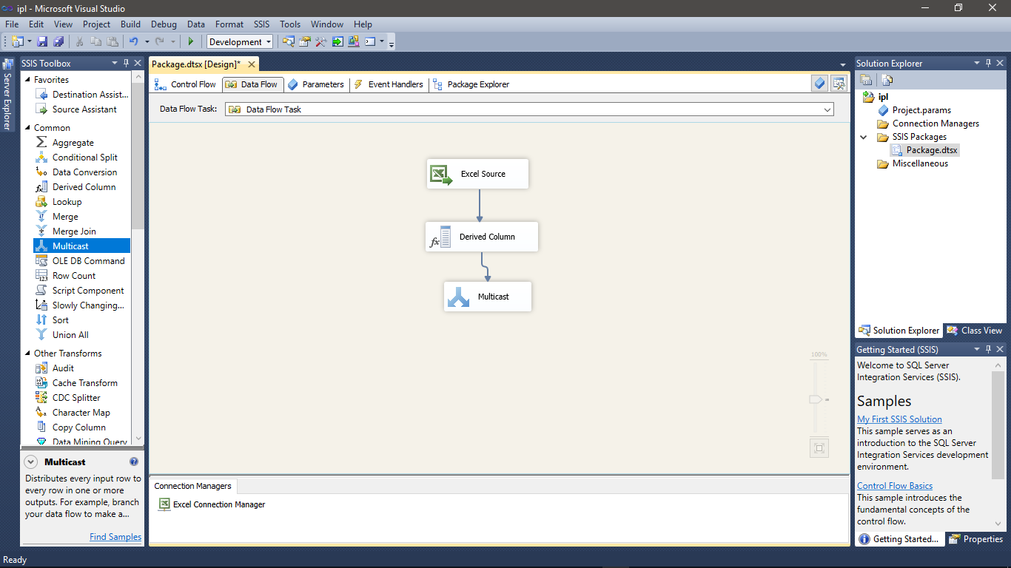

Slide 27
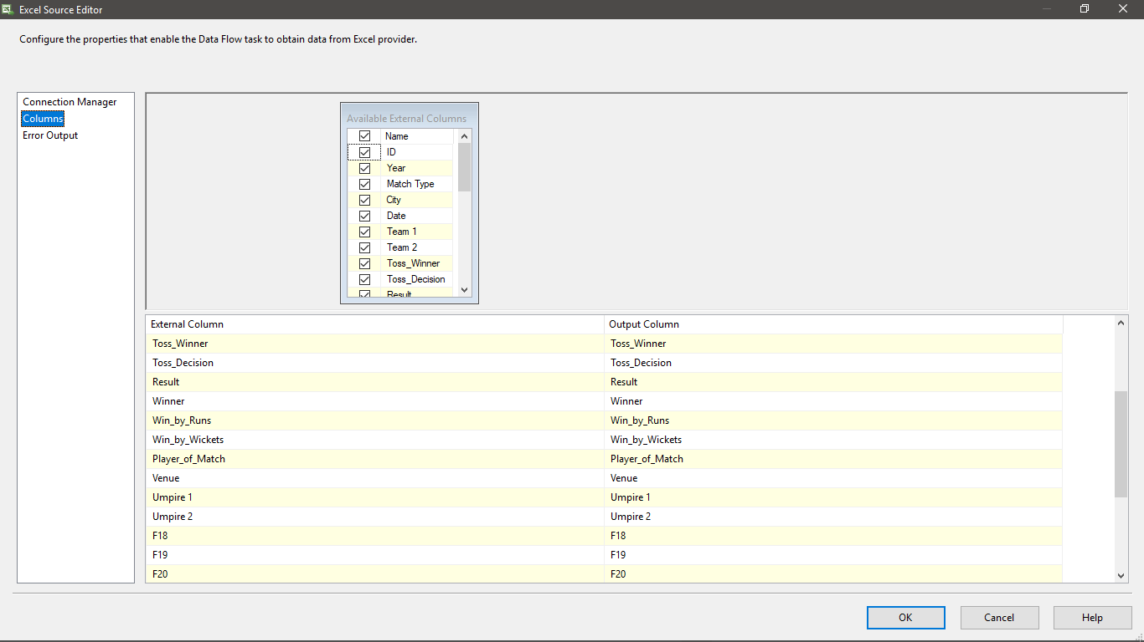

Slide 28
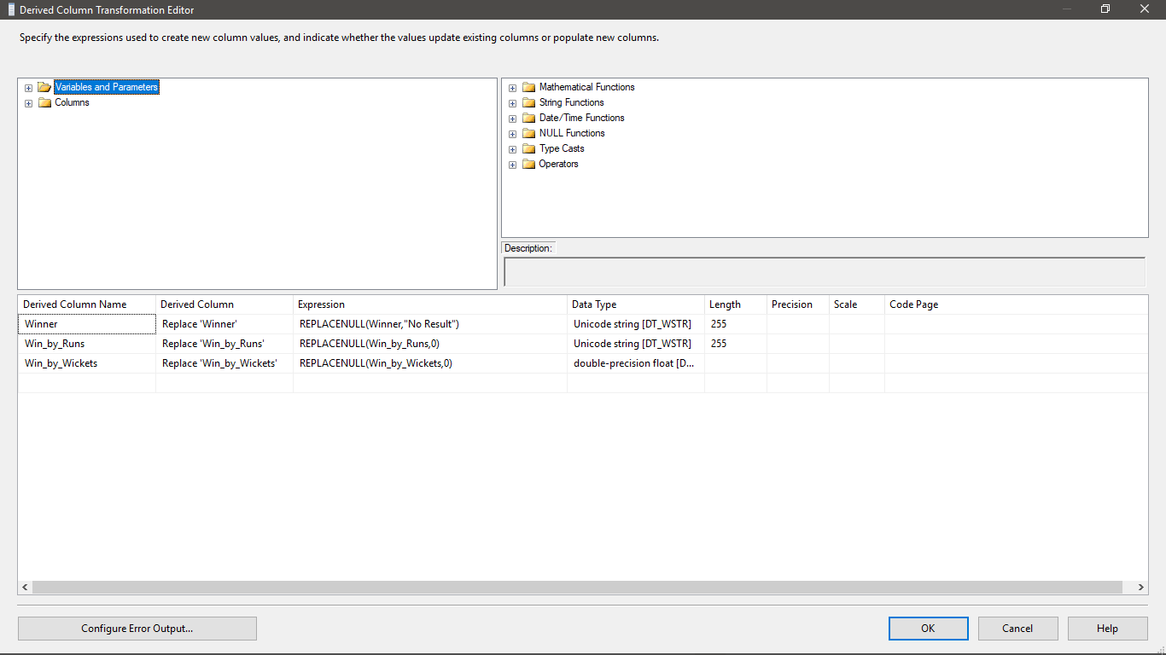

Slide 29
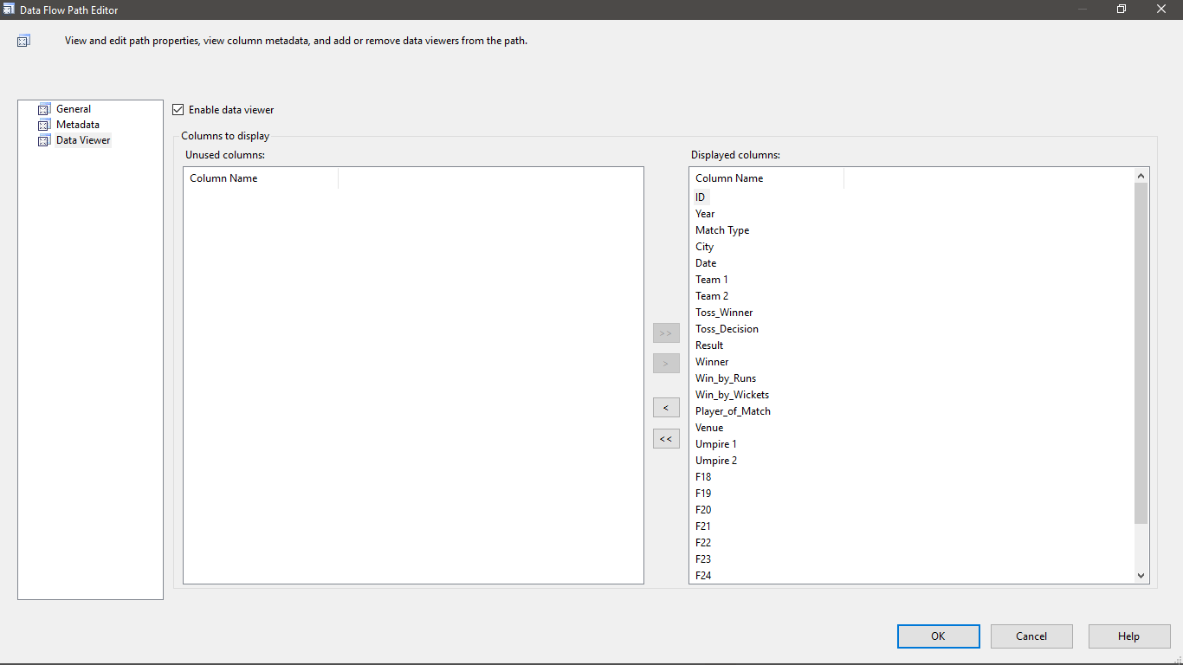

Slide 30
FUTURE SCOPE . . . ?

Slide 31

“The Next Big Thing Is Really Small”

